Slide 1
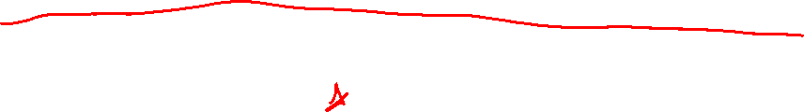
Section 2.7 Derivatives and Rates of Change
Lecture 1
IROC at last

Slide 2

Homework Submission to Canvas
Preview of section
Skim the section in text and write a short paragraph summary.
Give a bulleted list of all important definitions, theorems, and formulas without details.
Notes on video lectures
Take notes on everything written on slides including all details, worked examples, on-own activities, as well as your own thoughts and questions.
Try on-own activities first, then write down provided solution next to it for comparison.
Worked examples from the text
Write down the problem and attempt without looking at the solution.
Use the solution to write the best explanation you can.
Solutions to textbook exercises
Model approaches and explanations given in the video lectures and textbook examples.
Final reflection of section
List the key takeaways to remember as a bulleted list.
Video reflection (for some sections)
Write a 1 paragraph reflection on the video discussing what you found most interesting or useful.

Slide 3
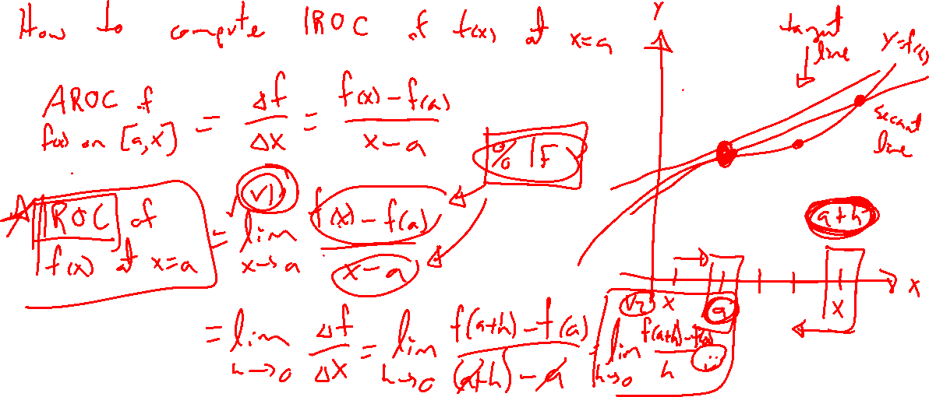
Recall: AROC as an approximation to IROC
Notes:
Previous definition / picture.
We now know limit tackles this process
Put our techniques to use

Slide 4
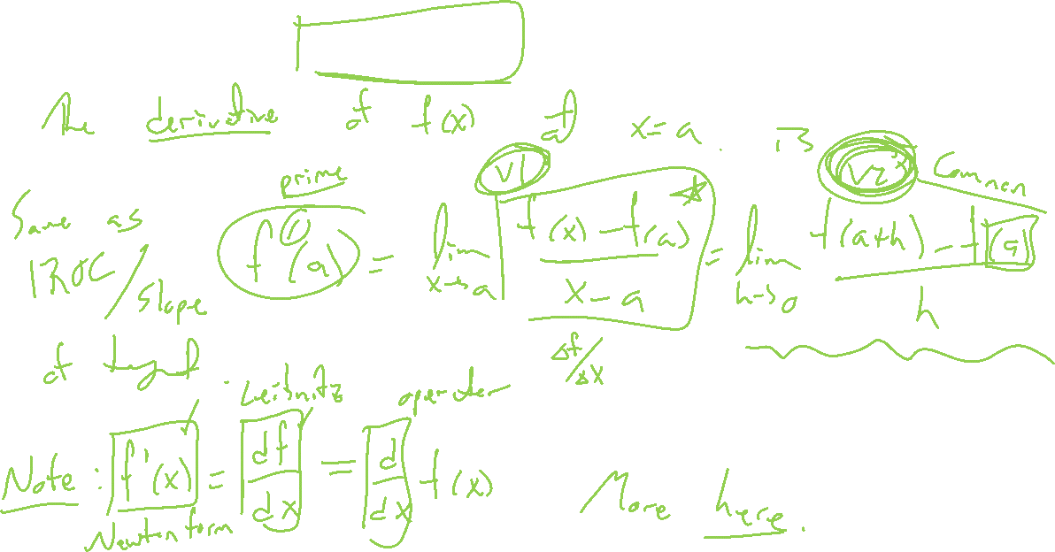
Definitions: Derivative at a point
Notes:
IROC, tangent line slope, derivative all the same
2 main formulas. Which is better? H formula has an advantage for limit calculation.

Slide 5
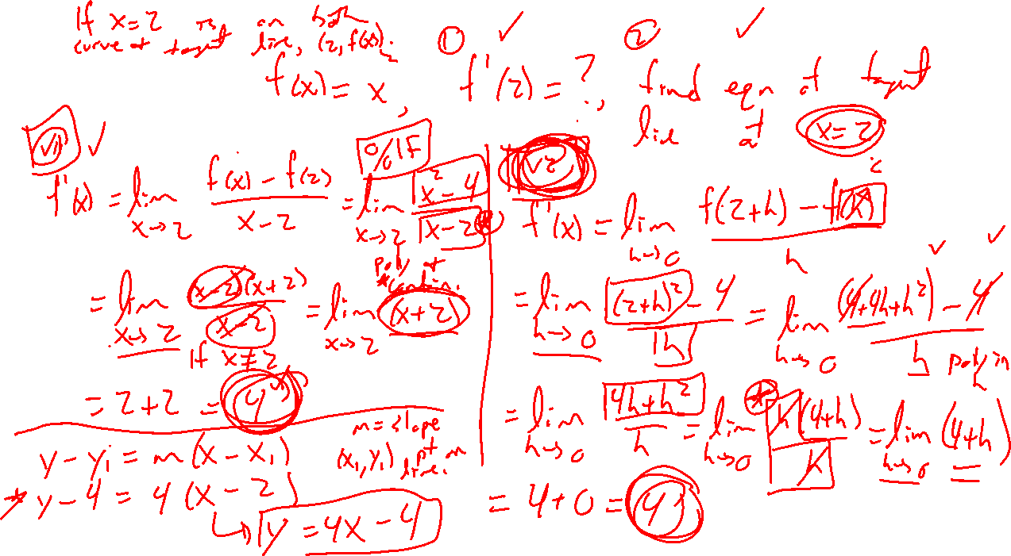
Example:
Notes:
Old problem: y=x^2 at x=2. Use two forms. Which is better?
Find the equation of the tangent line.

Slide 6
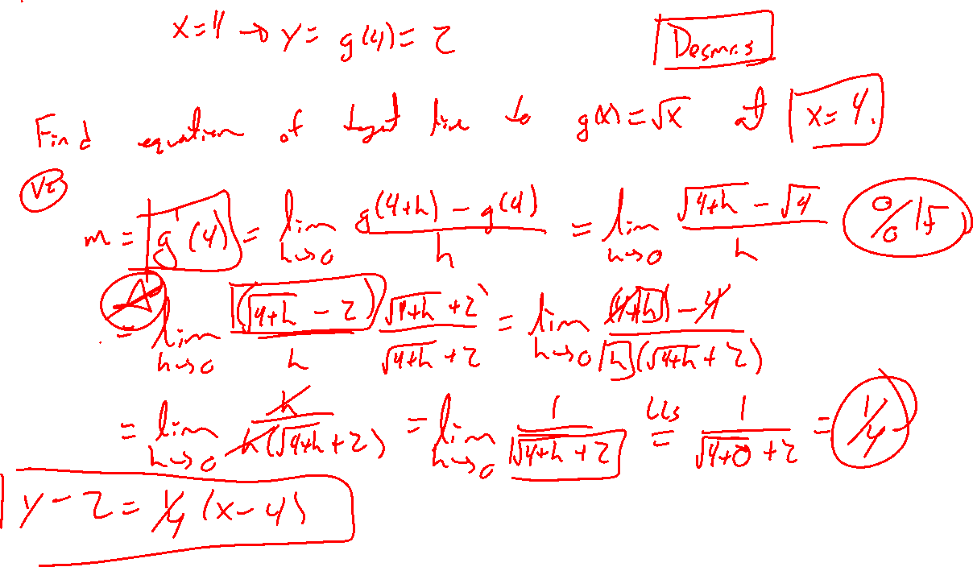
Example: Try on own
Notes:
F(x)=\sqrt(x) at x=4. Try one of two ways.
Demos.
Note, inverse of previous problem. Should know what to expect.
What if we allow that point to change? Consider the graph.

Slide 7

Section 2.7: Textbook Examples and Exercises
Rework examples 2, 3, 4, 5, 6 in the text. Steps:
Write down a problem.
Close the book and attempt on own.
Check / correct your solution against the text solution.
If needed, rewrite the problem to be of the quality of the text solution.
Complete exercises 9, 15, 23, 29
Write solutions of the same quality as in lecture and text solutions.
Check your solution against the answer in the back of the book.
Video reflection
None

Slide 8

Homework Submission to Canvas
Preview of section
Skim the section in text and write a short paragraph summary.
Give a bulleted list of all important definitions, theorems, and formulas without details.
Notes on video lectures
Take notes on everything written on slides including all details, worked examples, on-own activities, as well as your own thoughts and questions.
Try on-own activities first, then write down provided solution next to it for comparison.
Worked examples from the text
Write down the problem and attempt without looking at the solution.
Use the solution to write the best explanation you can.
Solutions to textbook exercises
Model approaches and explanations given in the video lectures and textbook examples.
Final reflection of section
List the key takeaways to remember as a bulleted list.
Video reflection (for some sections)
Write a 1 paragraph reflection on the video discussing what you found most interesting or useful.
Notes:
Mention graded for completion and quality of writing.

